Slide 1

SMART BUS TEAM BIG SHORT

Slide 2
OVERVIEW
Our Team
Background
Monetization
Motivation
Approach
Methodology
Solution and Demo
Issues and Risks
Future Work
Conclusion

Slide 3

WHO ARE WE
Team Big Short
Play on the title of a movie about the GFC called ‘The Big Short’
We have the tallest and shortest student
Meet our team
Aaron (零博山)
Jenny (祝昕玥)
Nero (刘丰元)
Ramon (周拉面)
Robert (汪嘉宇)
York (于珂)

Slide 4
BACKGROUND
Interested in the industry of the smart city
Transport is one of the two fundamental problems our society faces currently
Vehicular and public transport requires massive commitment from government
Narrowed scope to a smart school bus fleet management solution and app

Slide 5

MOTIVATION (SAFETY)
Children are vulnerable to predators when walking to or waiting at their stop
Have to wake significantly earlier, which affects their health and growth

Slide 6
MOTIVATION (TIME)
Students can spend more time at school and achieve an efficient education
Significant resources spent administrating student addresses and bus routes

Slide 7
MOTIVATION (MONEY)
School would pay an hourly salary to the bus drivers on their route
Parents lose significant billable hours driving their children to school

Slide 8
MONETIZATION
Small percentage of the fee paid to school for days the student rides the bus
Students are charged based on an inconvenience value their stop incurs
School pays a licensing fee which covers infrastructure and operating expenses

Slide 9

APPROACH
Built an app targeted at students and their parents
Students create account and supply address and school
Within app students can specify days they require a bus
Service dynamically rebuilds routes based on demand
Adapts to students being driven, sick or moving address

Slide 10
COMPETITORS
No one has properly solved this issue yet!
Closest competitor is: www.smartbus.org
Routes, tracking and nearest bus stop
There are school busses that collect stats
There are estimated arrival apps
No solution combines these technologies
We put the scheduling in the user’s hands
We bring the bus to the student’s front door

Slide 11
TEAM METHODOLOGY
Individual roles
Aaron: Database and App Architecture
Jenny: Android UI/UX Implementation
Nero: Android UI/UX Implementation
Ramon: Machine Learning, Project Coordination
Robert: Map View and Google API Calls
York: UI Design, Asset Creation, User Guide

Slide 12
TEAM METHODOLOGY
Agile is highly practical it comes high management overhead
Used subset of practices appropriate for our 56 hours (7 days)
Limited to a single sprint to develop a proof-of-concept
A stand-up meeting every second or third day
KTP performed only one at the end of the first week
A task board modelling the progress of each atomized subtask
Tasks with dependencies could not be performed async
While waiting for, members conducted research on their task
Once a member finished their assigned tasks they helped others

Slide 13
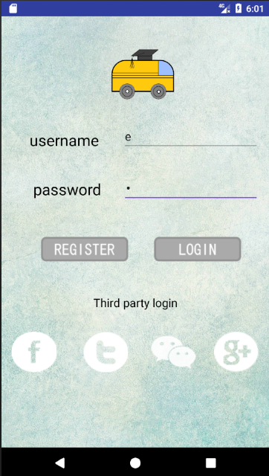
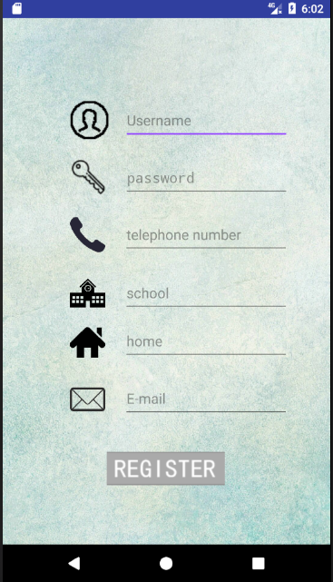

SOLUTION (ANDROID APP)
Main purpose: ease of use
Theme: blue

Slide 14

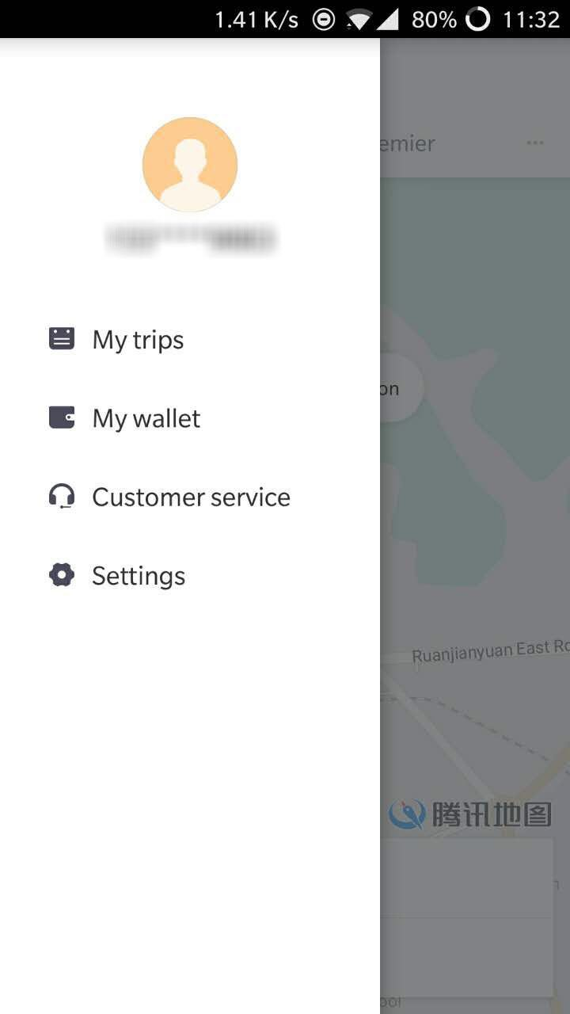
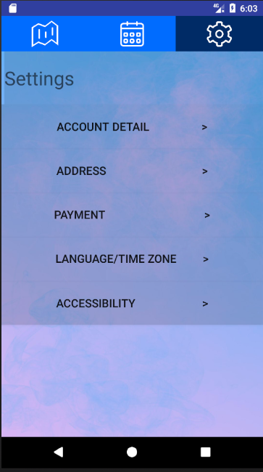
SOLUTION (APP UI/UX)
Target users: students and their parents
App has to be accessible for a generation that has not grown up with technology

Slide 15

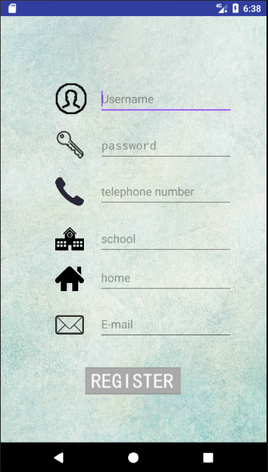
SOLUTION (APP LOGIN)
Light color as background
Third party login icons
Concise/neat login page
Images and text tell users what they are doing exactly
Users can understand what they need to input on each line

Slide 16
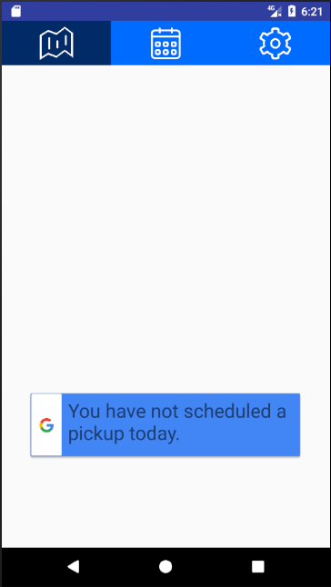
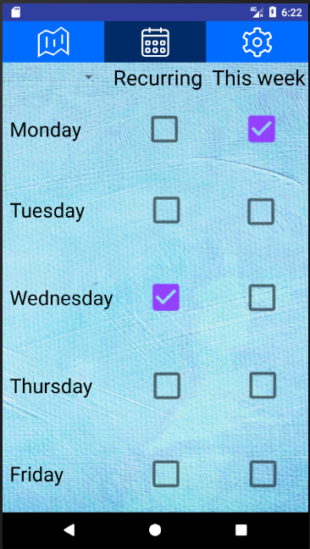

SOLUTION (APP UI/UX)
Tabs are easier than a menu
Simple understandable icons that imply context
Meaning is easily inferred
Selected tab has a darker color than the others

Slide 17
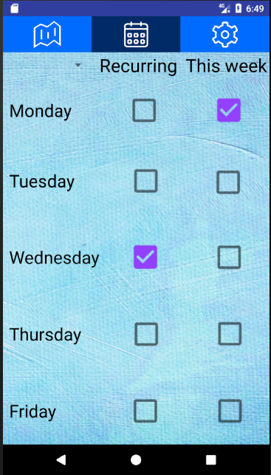
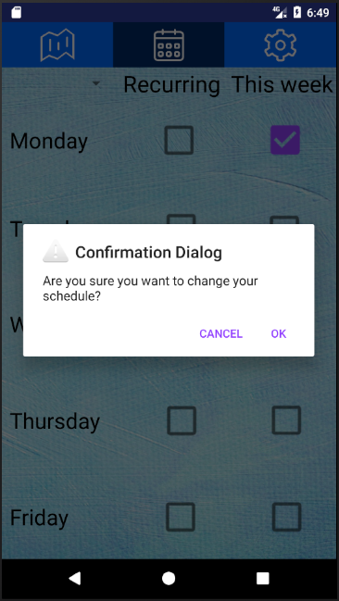
SOLUTION (APP UI/UX)
Text and checkboxes are optimized for small screen touch input devices
Confirmation dialog provides feedback enforcing the request has been made

Slide 18
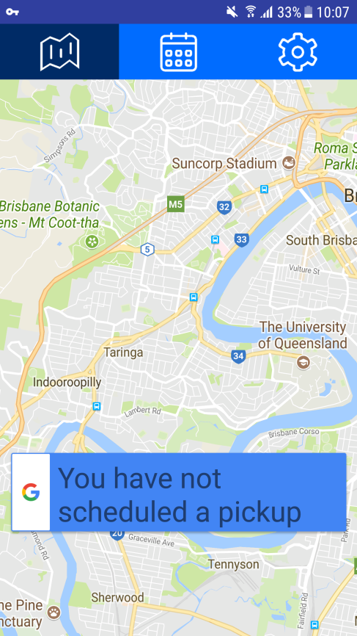
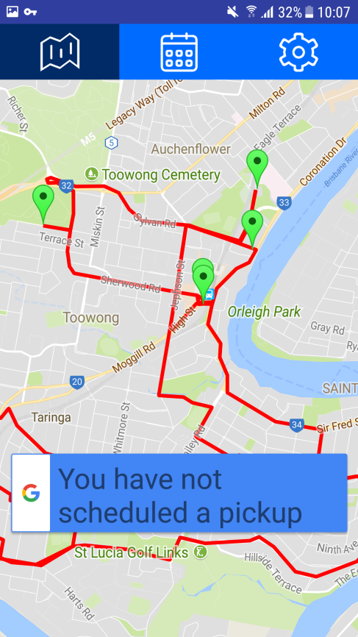
SOLUTION (ANDROID MAPS)
Easier to integrate Google Maps to Android development
Google maps give you the most optimized routes based on real time traffic data

Slide 19
SOLUTION (MAPS API)
Make a RESTful API request through HTTP and decode the JSON response
Uses OpenStreetMap API for geocoding (converting addresses to coordinates)
Used Google Maps API for directions and distance between two location nodes

Slide 20
SOLUTION (DATABASE ARCH.)
Requires a database to store student
Accounts
Geolocations
Scheduling
Used SQLite within the Android app
Would actually be stored on the server
Developed library to abstract away SQL

Slide 21
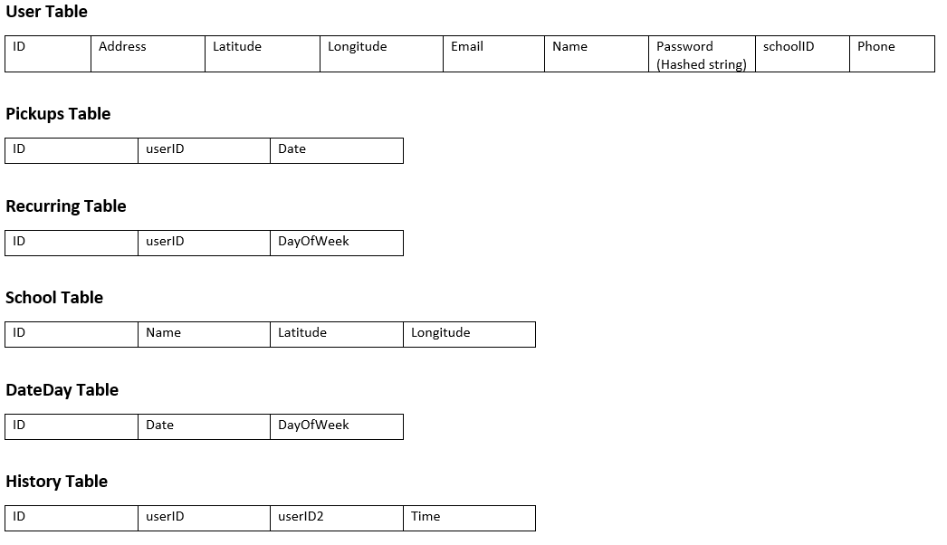
SOLUTION (DATABASE SCHEMA)

Slide 22


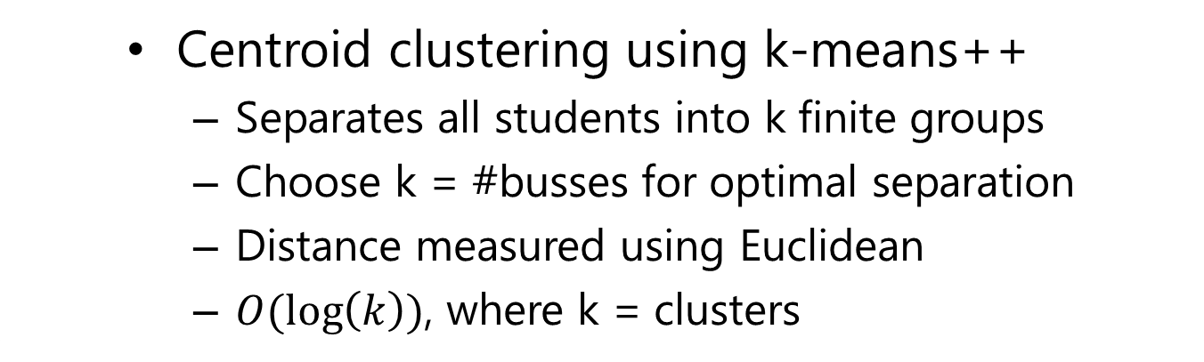
SOLUTION (MACHINE LEARNING)
Centroid clustering using k-means++
Separates all students into k finite groups
Choose k = #busses for optimal separation
Distance measured using Euclidean
$O(\log\left(k\right))$, where k = clusters

Slide 23
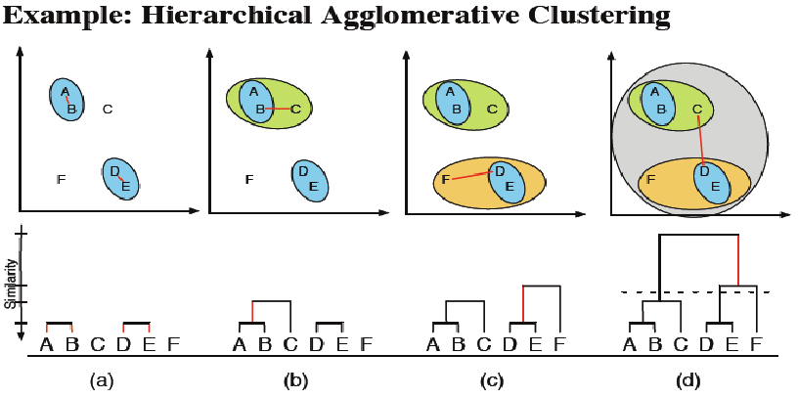
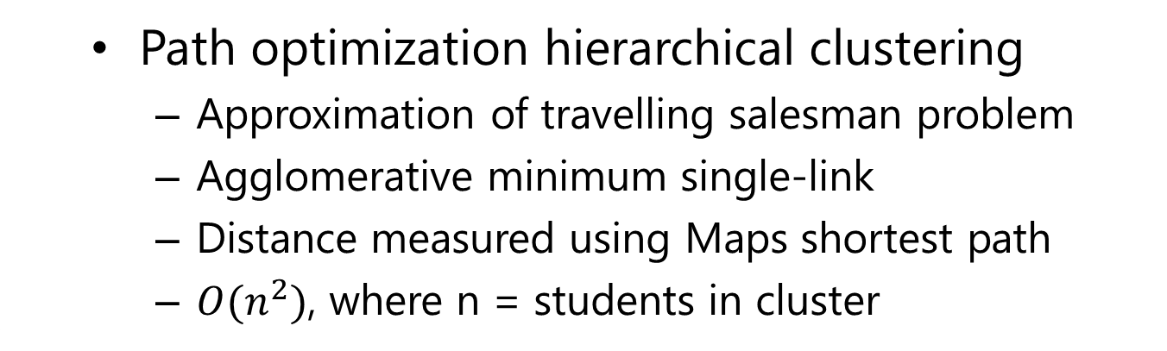
SOLUTION (MACHINE LEARNING)
Path optimization hierarchical clustering
Approximation of travelling salesman problem
Agglomerative minimum single-link
Distance measured using Maps shortest path
$O(n^{2})$, where n = students in cluster

Slide 24
SOLUTION (SERVER MODEL)
Updates app by pushing CI builds to store
Purge the scheduled pickups each week
Generates new pickups based on recurring
Communicates with bus for location status

Slide 25
ISSUES AND RISKS
OpenStreetMaps
Hard to integrate into Android in short time
Only 3rd party libraries with complex dependencies
Does not provide as many RESTful API features
Google Play Services
Blocked in China, includes Maps for Android
Resolved by using a VPN (temporary fix)
Ultimately migrate to OSM in China
Asynchronous API Calls
Android was not performing concurrently
Main task was blocking API calls when using Thread.sleep()
Changed to synchronous, creates delay especially with VPN

Slide 26
FUTURE WORK
Technical
Management
Server implementation
OpenStreeMaps
iOS application
Payment integration
Social integration
Concrete business plan
Survey usage interest
Estimate ROI and ROR
Develop exit strategy
Acquire funding

Slide 27
CONCLUSION
We have incubated an idea that is:
Feasible
Valuable
Profitable
The idea is perfectly scoped and unique
No direct threat from competitors
We have the first-movers advantage

Slide 28

QUESTIONS

